Slide 1
EPA Air Quality Pipeline
Project 3, Team 2
Use Case for US Environmental Protection Agency

Slide 2
Agenda
Project Overview
Pipeline Architecture
Ingestion, Governance & Storage
ETL - raw to curated data
Monitoring the Pipeline
Data Warehouse & Visualization
Pricing
Notes:
Jacob

Slide 3
Project Overview
Design an end-to-end data pipeline with the following requirements using AWS:
Ingestion: historical and real time global air quality metrics and weather
Storage: S3 bucket with bronze, silver, and gold layers
ETL: data cleaning, transformation, and aggregation through gold layer
Consumption:
Data warehouse
Visualization
Security, monitoring, logging
Orchestration
Notes:
Jacob

Slide 4
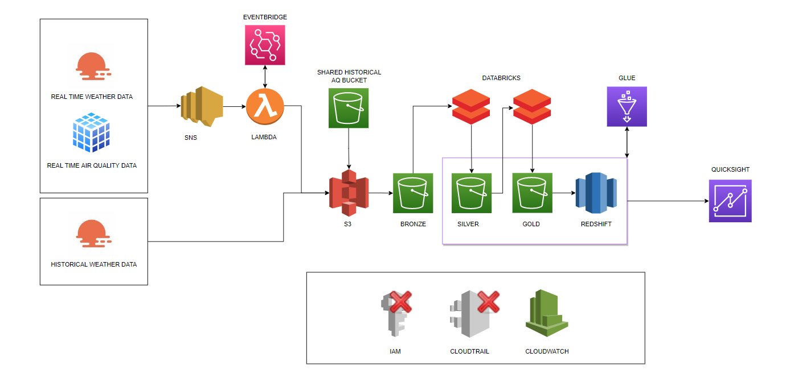
AWS Services and Tools
Notes:
Jacob

Slide 5
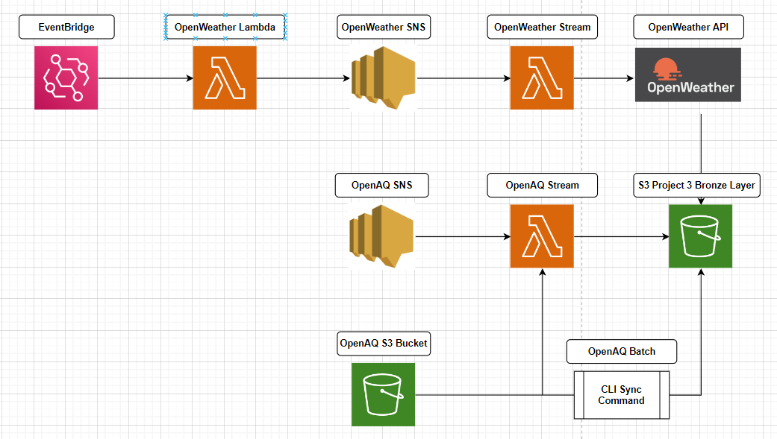
Data Ingestion
Tasks
Batch import historical data
Stream real-time openaq data
Obtain weather data from external sources
Notes:
Jose -

Slide 6
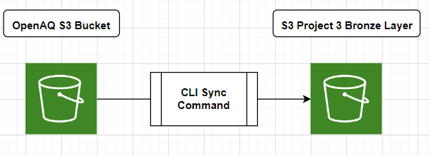
Data Ingestion - Historical Batch Air Quality
Used ‘sync’ command in amazon CLI
Took 6 hours to copy data up til March 2022
Notes:
Jose - For the batch data
We decided to use the “realtime” folder for the historical data
Copied over the data using CLI
Had to restart a couple of times because the session key expired

Slide 7
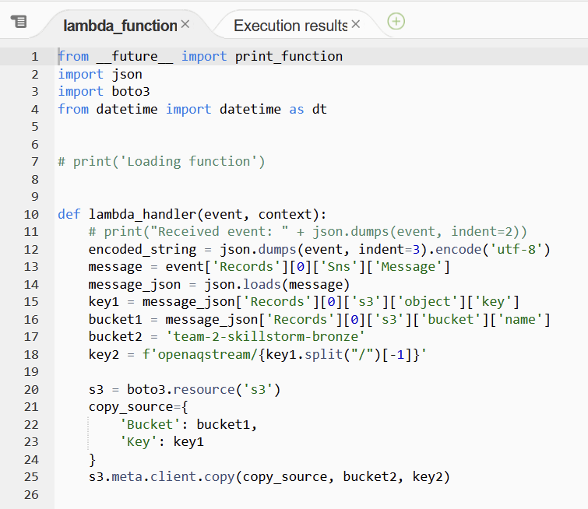
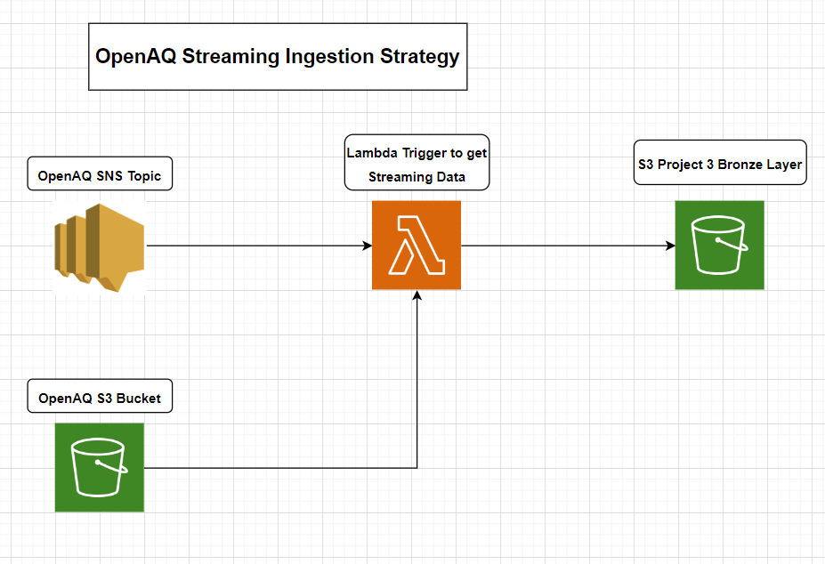
Data Ingestion - Streaming Air Quality
Notes:
John S - show ingestion bucket in S3 bronze, openaqstream folder

Slide 8





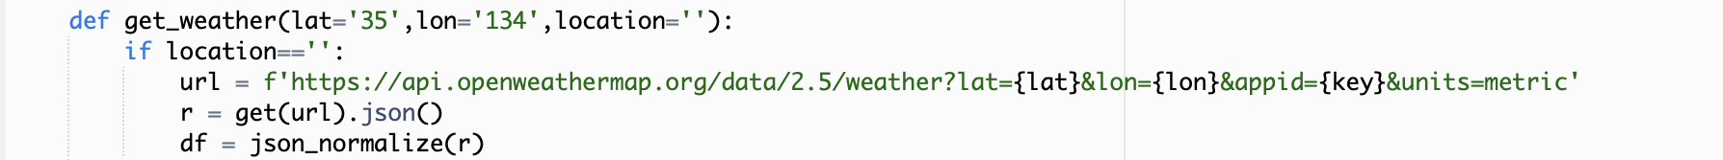
Data Ingestion - Streaming Weather
*Free API Limitations
Notes:
Peter -
Lambda - open weather function team_2_open_weather_sns_trigger
Eventbridge event

Slide 9
Data Governance Policy
AQ Data Exploration | Cleaning
Attribution, SourceName, SourceType: who collected the air quality data Mobile: boolean if station is mobile Date Local: Local time for air quality collection | Unnecessary Columns dropped
City, Country, Location, Coordinates: where the air quality is being collected | Null Policy - fill or drop require coordinates & metrics, else drop row
Parameter, Unit, Value: metrics for air quality, (µg/m3) micrograms per cubic meter | Data Types Uniform metric units
Date: Contains local time and utc time UTC: Universal time for air quality collection | Data Partitioned by Year or Location Data is ingested every 15 minutes
Notes:
Philip

Slide 10


Data Cleaning (Bronze to Silver)
shared-bronze-layer
Open-aq one time batch
team-2-silver
Open-aq stream job
team-2-bronze
Open weather stream job
Notes:
Philip’s “Team-2-Bronze-Silver(Batch)”
Jacob’s OpenWeather notebook

Slide 11
Data Governance Policy
Open Weather API Data | Cleaning
Longitude, Latitude, temp, feels_like, humidity, wind_speed, wind_gust, Datetime, sea_level, ground_level | Kept 10 / 30 columns
Notes:
Jacob

Slide 12
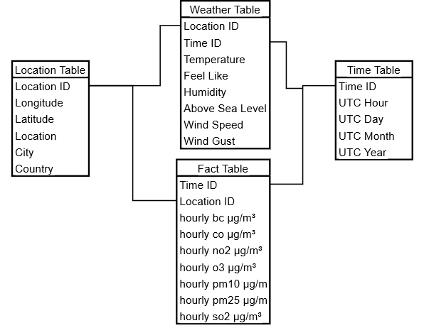
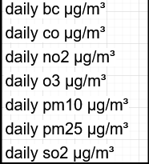
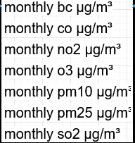
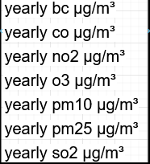
Data Aggregation (Silver to Gold)
team-2-skillstorm-silver
Databricks Spark Job
Team_2_Silver_gold
team -2-skillstorm-gold
Notes:
Chase: Discuss pipeline and star schema
Databricks Notebook (Silver-Gold-Air) has all of it included
– last modified feature, pulling in specific files, partitioning by.

Slide 13
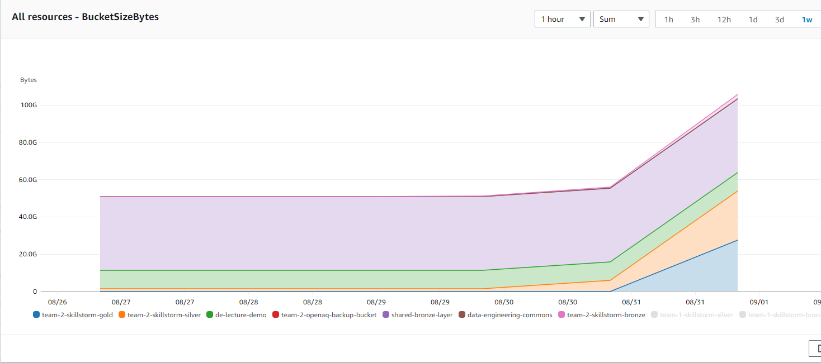
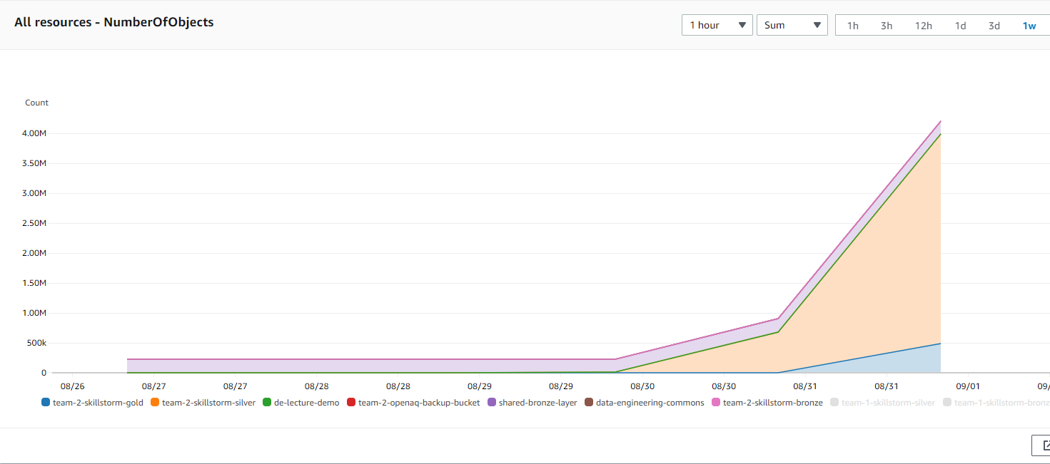
Monitoring, Logging, Auditing (Cloudwatch & Glue)
Cloudwatch Dashboard S3 BucketSizeBytes
Cloudwatch Dashboard S3 NumberOfObjects
Notes:
Jeff -
Link to cloudwatch alarm: https://us-east-1.console.aws.amazon.com/cloudwatch/home?region=us-east-1#alarmsV2:alarm/Team_2_Project_3_Cloudwatch_Alarm?~(namespace~'AWS*2fBilling)
Link to cloudwatch dashboards:
https://us-east-1.console.aws.amazon.com/cloudwatch/home?region=us-east-1#dashboards:name=Team_2_Project_3_Cloudwatch_S3;start=PT168H
Glue Crawler
Glue Database
Glue Table of choice

Slide 14
Data Warehouse (Redshift)
Walkthrough:
– Redshift Demo –
Notes:
Nakul - views, basic functions
Redshift, team2 cluster, query editor v2, connect to cluster user = awsuser
Queries folder?

Slide 15
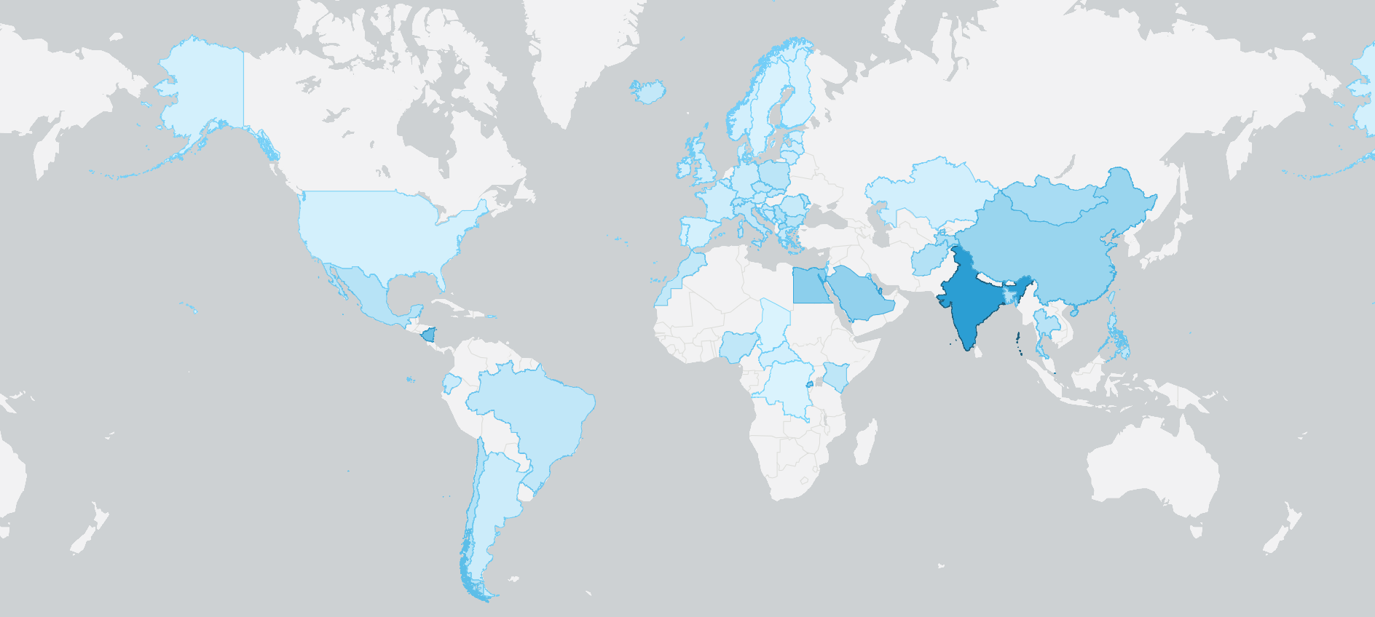
Data Visualization (Quicksight)
Notes:
John Mackin -

Slide 16
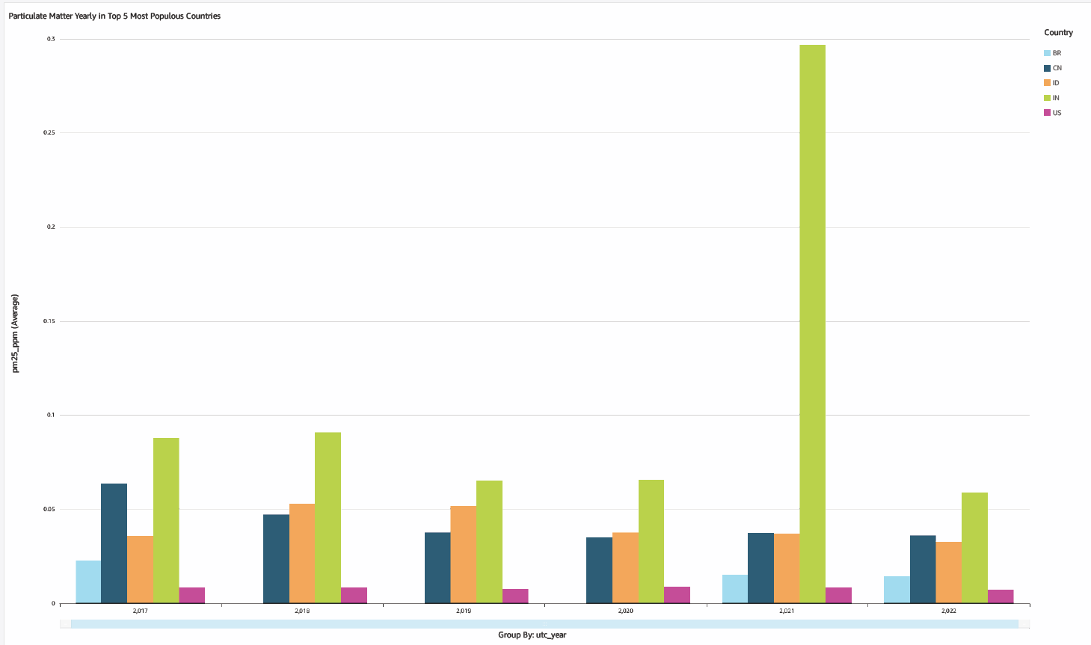

Slide 17
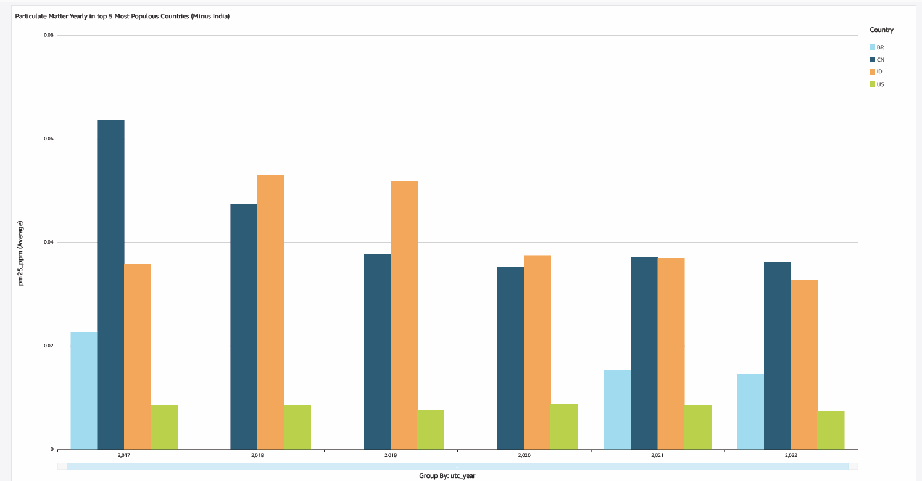

Slide 18
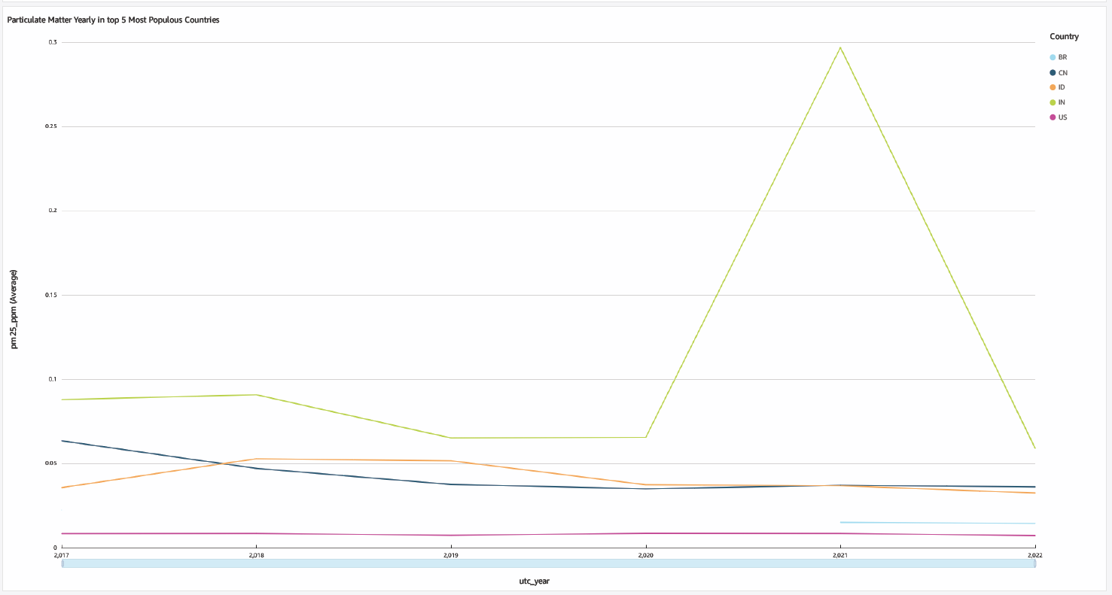

Slide 19
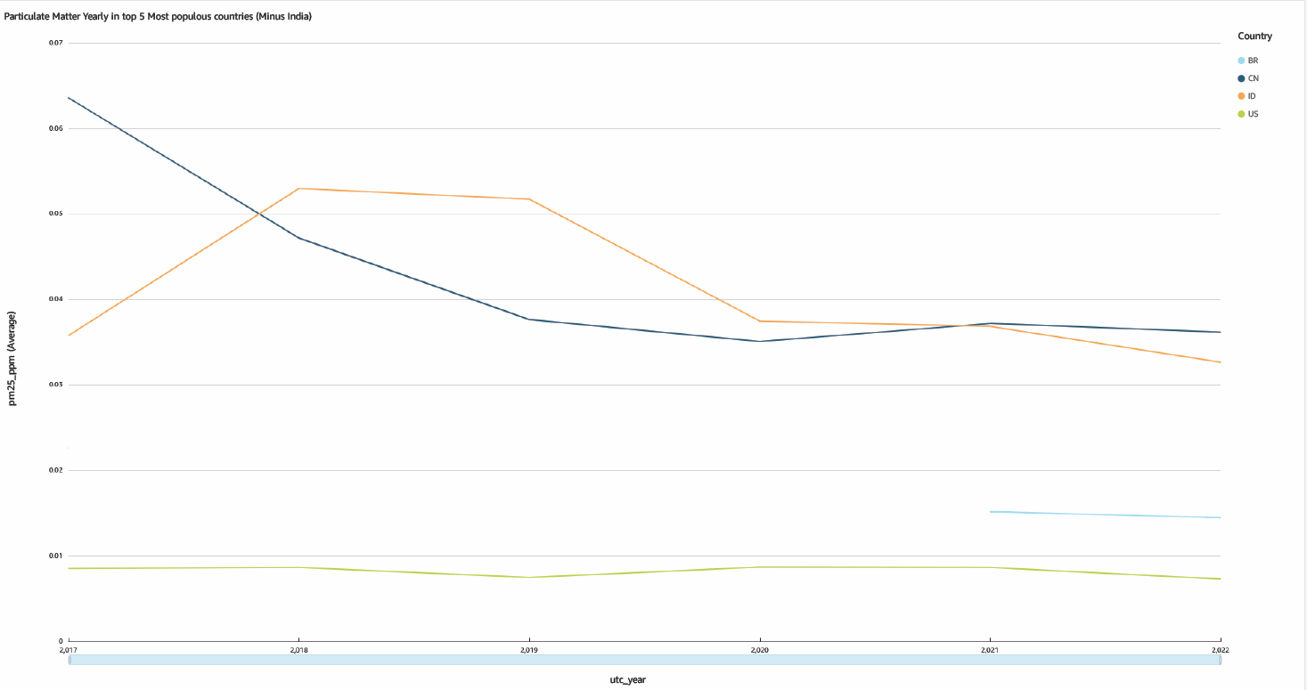

Slide 20
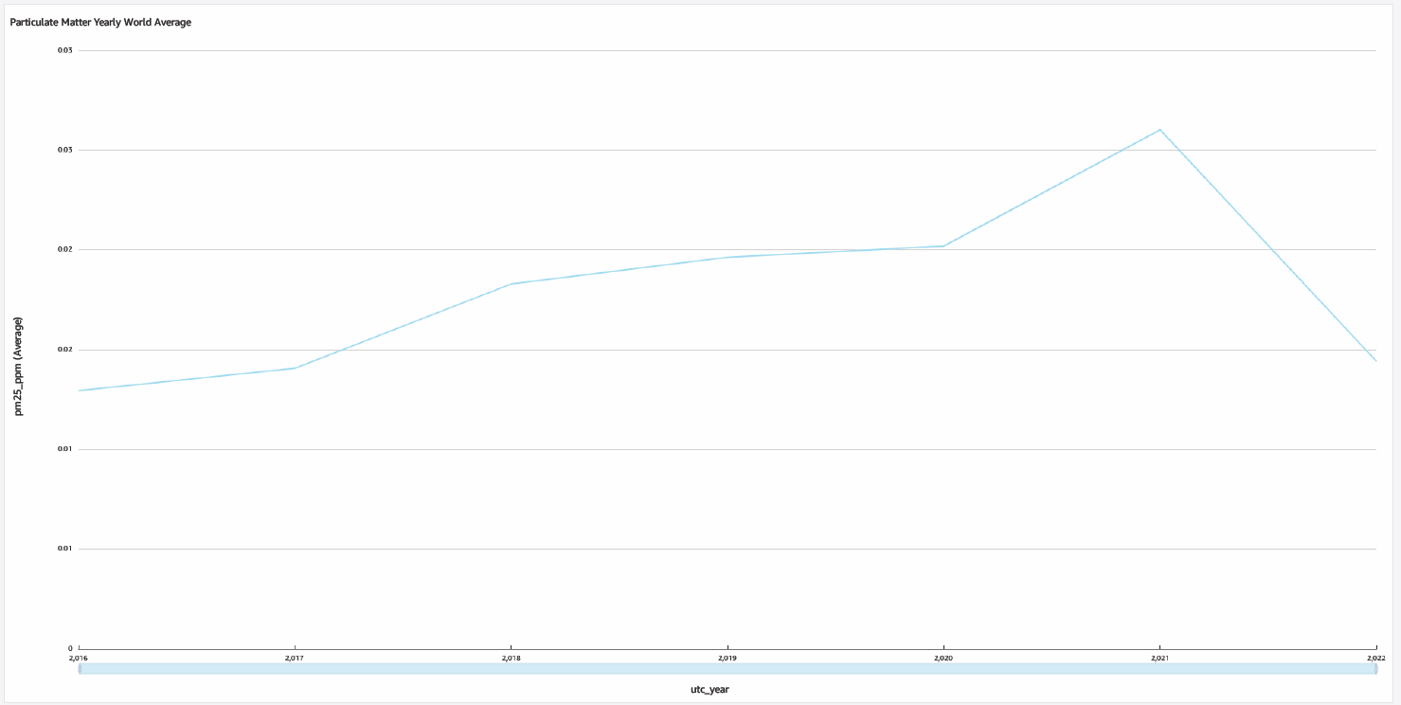

Slide 21
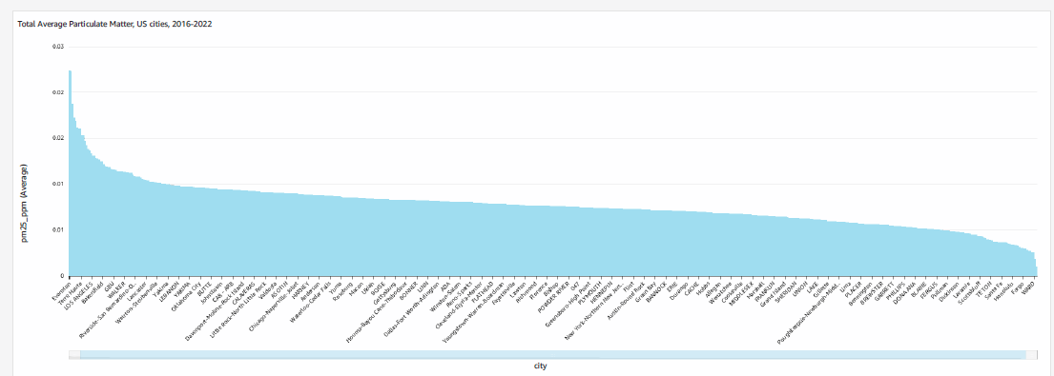

Slide 22
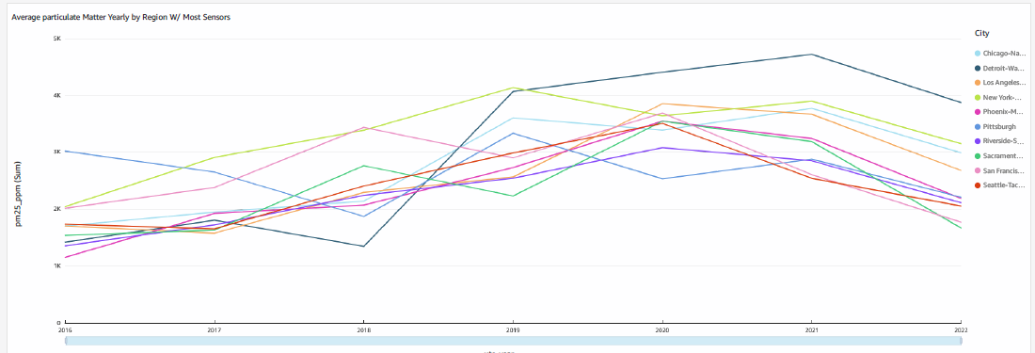

Slide 23
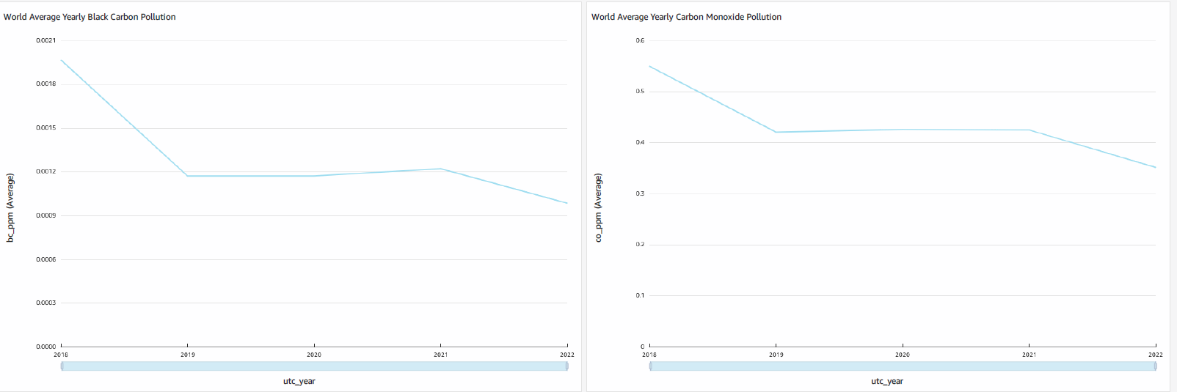
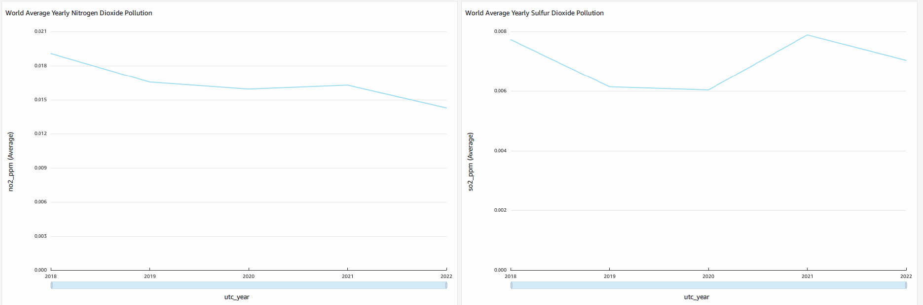

Slide 24
Pricing Estimate
PROJECT REQ | SERVICE | DESCRIPTION |  | PRICE / MO
Ingestion Streaming | AWS SNS | Real time data = $0 < 1,000,000 requests |  | $0.00
ETL | Databricks Lambda | Databricks Standard i3.xlarge 4CPU/30GB, 5 instances / cluster x 4hrs/day, 30 days/mo Lambda $0/mo |  | $240.00
Storage | AWS S3 | Glacier Instant Retrieval = $0.004/GB/month x 50GB/mo |  | $0.20
Storage Catalog | AWS Glue | 4 crawlers x 0.02 hours x 0.44 USD per DPU-hour |  | $0.04
Storage Security | AWS IAM | User permissions, Free Tier |  | $0.00
Data Warehouse | AWS Redshift | Reserved Instance, 1 yrs, US East, no upfront cost Dc2.large, 640GB RAM, 8 nodes, 2 clusters* |  | $161.00
Data Visualization | AWS Quicksight | Enterprise Level: 2 Authors, 5 Readers, 30 days/mo $250 base fee |  | $49.40
Monitoring | AWS Cloudwatch AWS Cloudtrail | Metrics on all stages, thresholds and alarms, user activity |  | $0.00
Orchestration | Apache Airflow Hypothetical | Environment monthly costs: 357.70 USD Worker monthly costs: 6.69 USD Scheduler monthly costs: 0 USD Meta database monthly costs: 0.10 USD |  | $364.49
Total:
$815.13
per month
Notes:
Jeff - Hypotheticals vs Actual, initial up front in costs vs future stability, $48 for initial boot up of Databricks 24/7
AQ Streaming Bronze = approx 13mb files every 10min = 13mb x 6 = 78mb per hour x 12 hrs = 936MB per day
AQ Streaming Silver = approx 1.3mb files every 10 sec = 1.3mb x 6 = 7.8mb per min x 20min = 156mb/hr x 24hrs = 3,744MB per day
AQ Streaming Gold = approx 88mb per month
Total Streaming = approx 140GB per month increase

Slide 25
THANK YOU

